Slide 1
What is Good Data Visualization?

Slide 2
Why Data Visualization?
Data exploration
Data analysis
Presentation
Sometimes your analysis ends with data visualization
Such “model free” analysis is very popular in big data analytics

Slide 3
Principles of Graphical Design
Edward Tufte: “Graphical excellence is that which gives to the viewer the greatest number of ideas in the shortest time with the least ink in the smallest space.”
Stephen Few: “Our primary visual design objective will be to present content to readers in a manner that highlights what’s important, arranges it for clarity, and leads them through it in the sequence that tells the stories best.”

Slide 4
Some Principles
Erase as much “non-data-ink” as possible.
Ensure that “non-data-ink” plays a supporting role.
Think carefully about how to organize/prioritize important data ink.
Try several options, revise.

Slide 5
Scaling
Few:
Maintain visual correspondence to quantity.
Beware of starting a scale at a non-zero value.

Slide 6
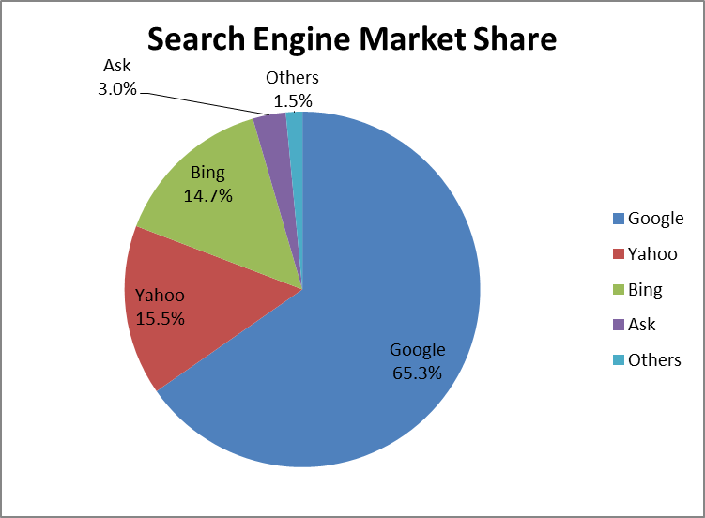
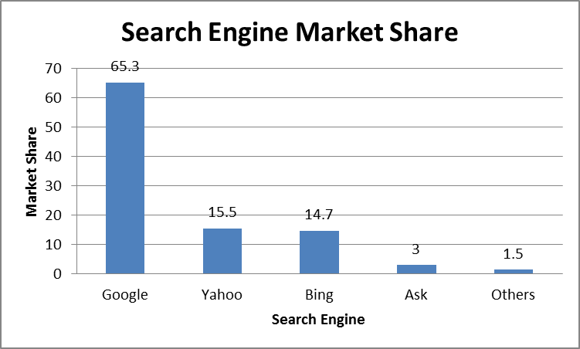
Pie vs. Bar
Few: Avoid pie charts.

Slide 7
Time Series
Few:
Avoid using points for time series.
Use bars to emphasize individual values.
Use lines to emphasize trend.

Slide 8

3D Plotting
Tufte & Few: Avoid 3d graphs and other gimmicks.

Slide 9
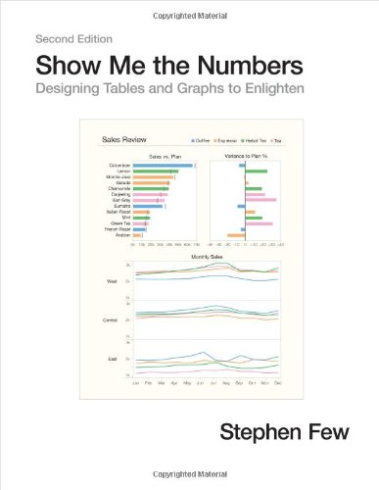
For More Information
Edward Tufte, The Visual Display of Quantitative Information, 1983.
Also edwardtufte.com
Stephen Few, Show Me The Numbers, 2012.
Also http://www.perceptualedge.com

Slide 10
Specialized Visualization Software
Tableau: http://www.tableausoftware.com/
Qlik: http://www.qlik.com
Spotfire: http://spotfire.tibco.com/

